Slide 1
Rejeição do aloenxerto de fígado mediada por anticorpos: uma atualização e uma perspectiva clínico-patológica
John Hart, MD
Universidade de Chicago, EUA

Slide 2
Declaração de Conflito de Interesse
Dr Hart não ter conflito de interesse a declarar
Em caso afirmativo, especificar: associação financeira relevante
nos últimos 12 meses e que esteja relacionada ao conteúdo da
atividade científica
Exigência da RDC Nº 96/08 da ANVISA

Slide 3
Liver Allograft Rejection
Antibody Mediated Rejection (AMR):
  ABO incompatible donor organ
  HLA antigens / lymphocytotoxic antibodies
Plasma cell rich rejection
Acute T-cell mediated rejection
Chronic (ductopenic) rejection

Slide 4
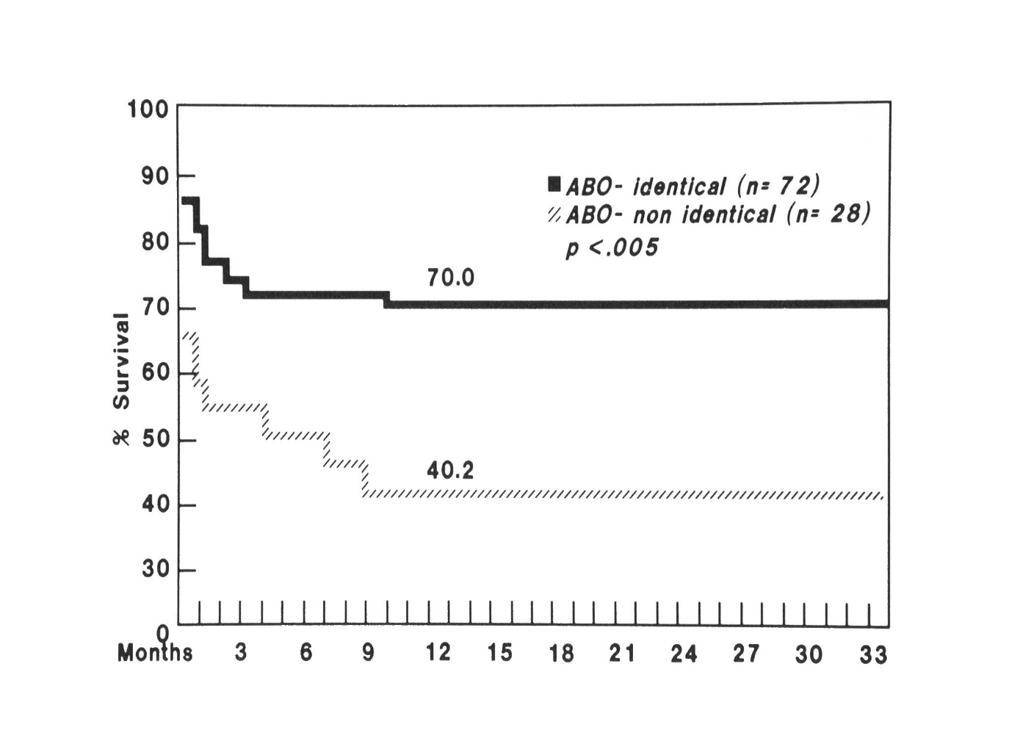
Antibody Mediated Rejection
Busuttil RW et al. Ann Surg 1987; 206: 387-402.

Slide 5

AMR - ABO incompatible graft
Clinical features:
  Exclusion of other causes (vascular thrombosis, sepsis, hypoperfusion)
  Poor graft function (reduced bile production, poor clotting, falling PLT count)
  Swollen allograft with vascular compromise
Histologic features:
  Centrilobular hepatocyte ballooning/necrosis
  Portal edema, bile ductular reaction and cholestasis
  Endothelial cell swelling/injury, sinusoidal thrombi
  Scattered acidophil bodies progressing to parenchymal necrosis
  Necrotizing arteritis
Hart J, Lewin K. Pathology 1994; 3:207-50

Slide 6
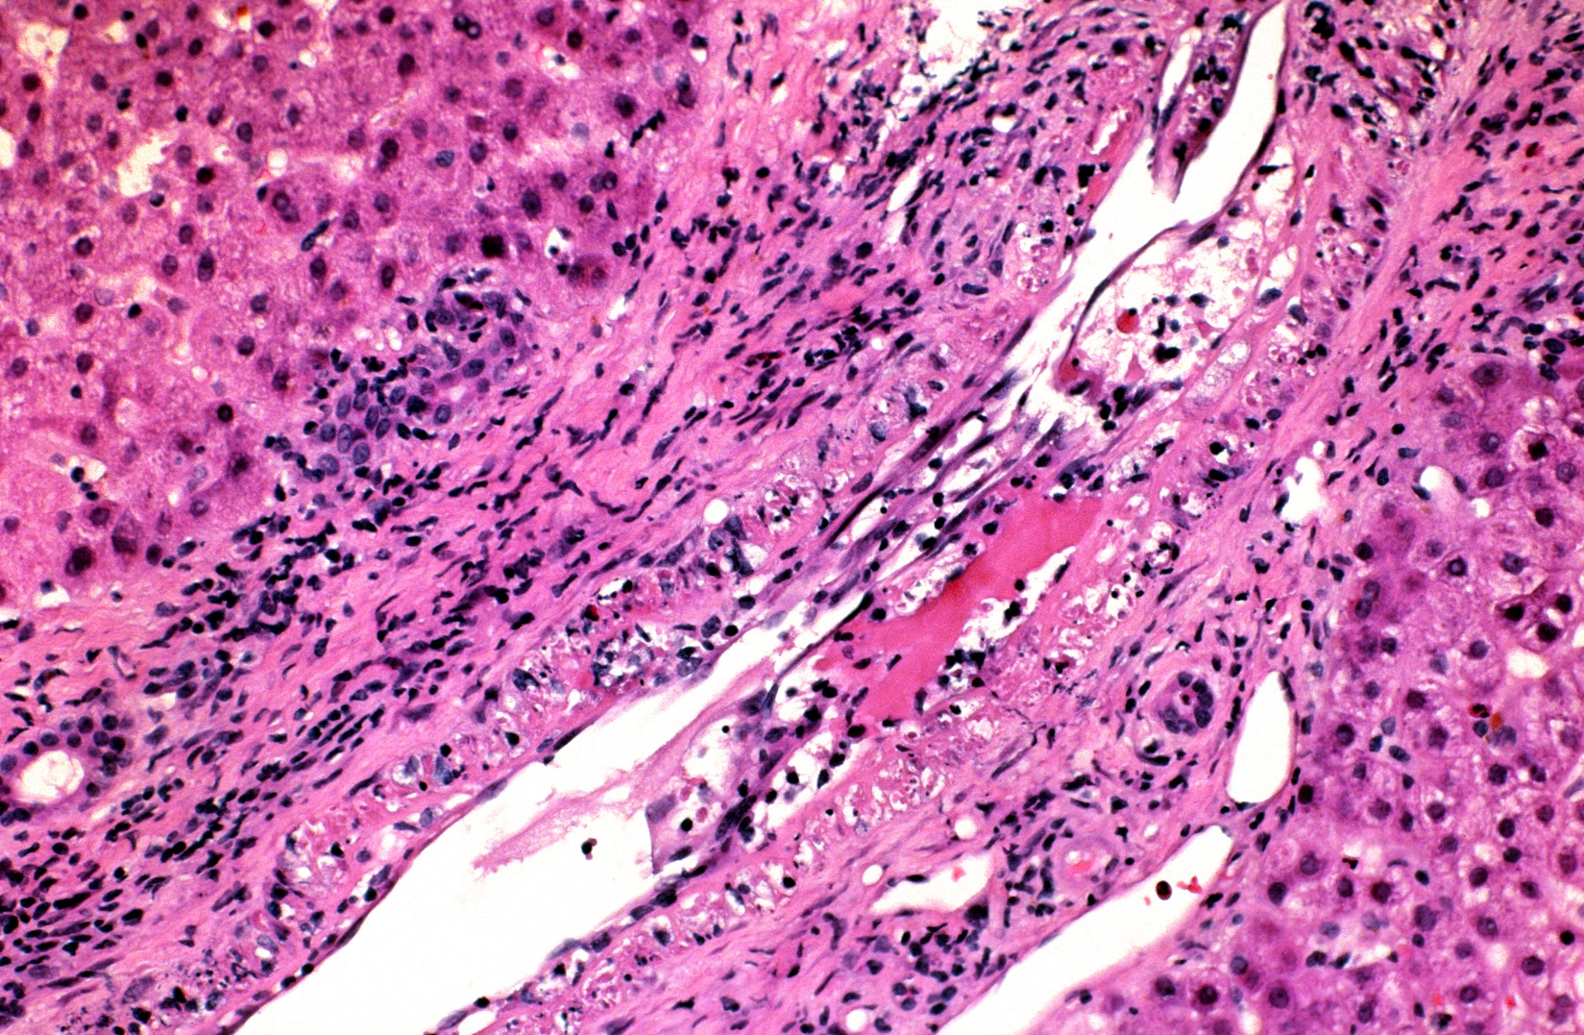
Necrotizing Arteritis
Necrotizing arteritis

Slide 7
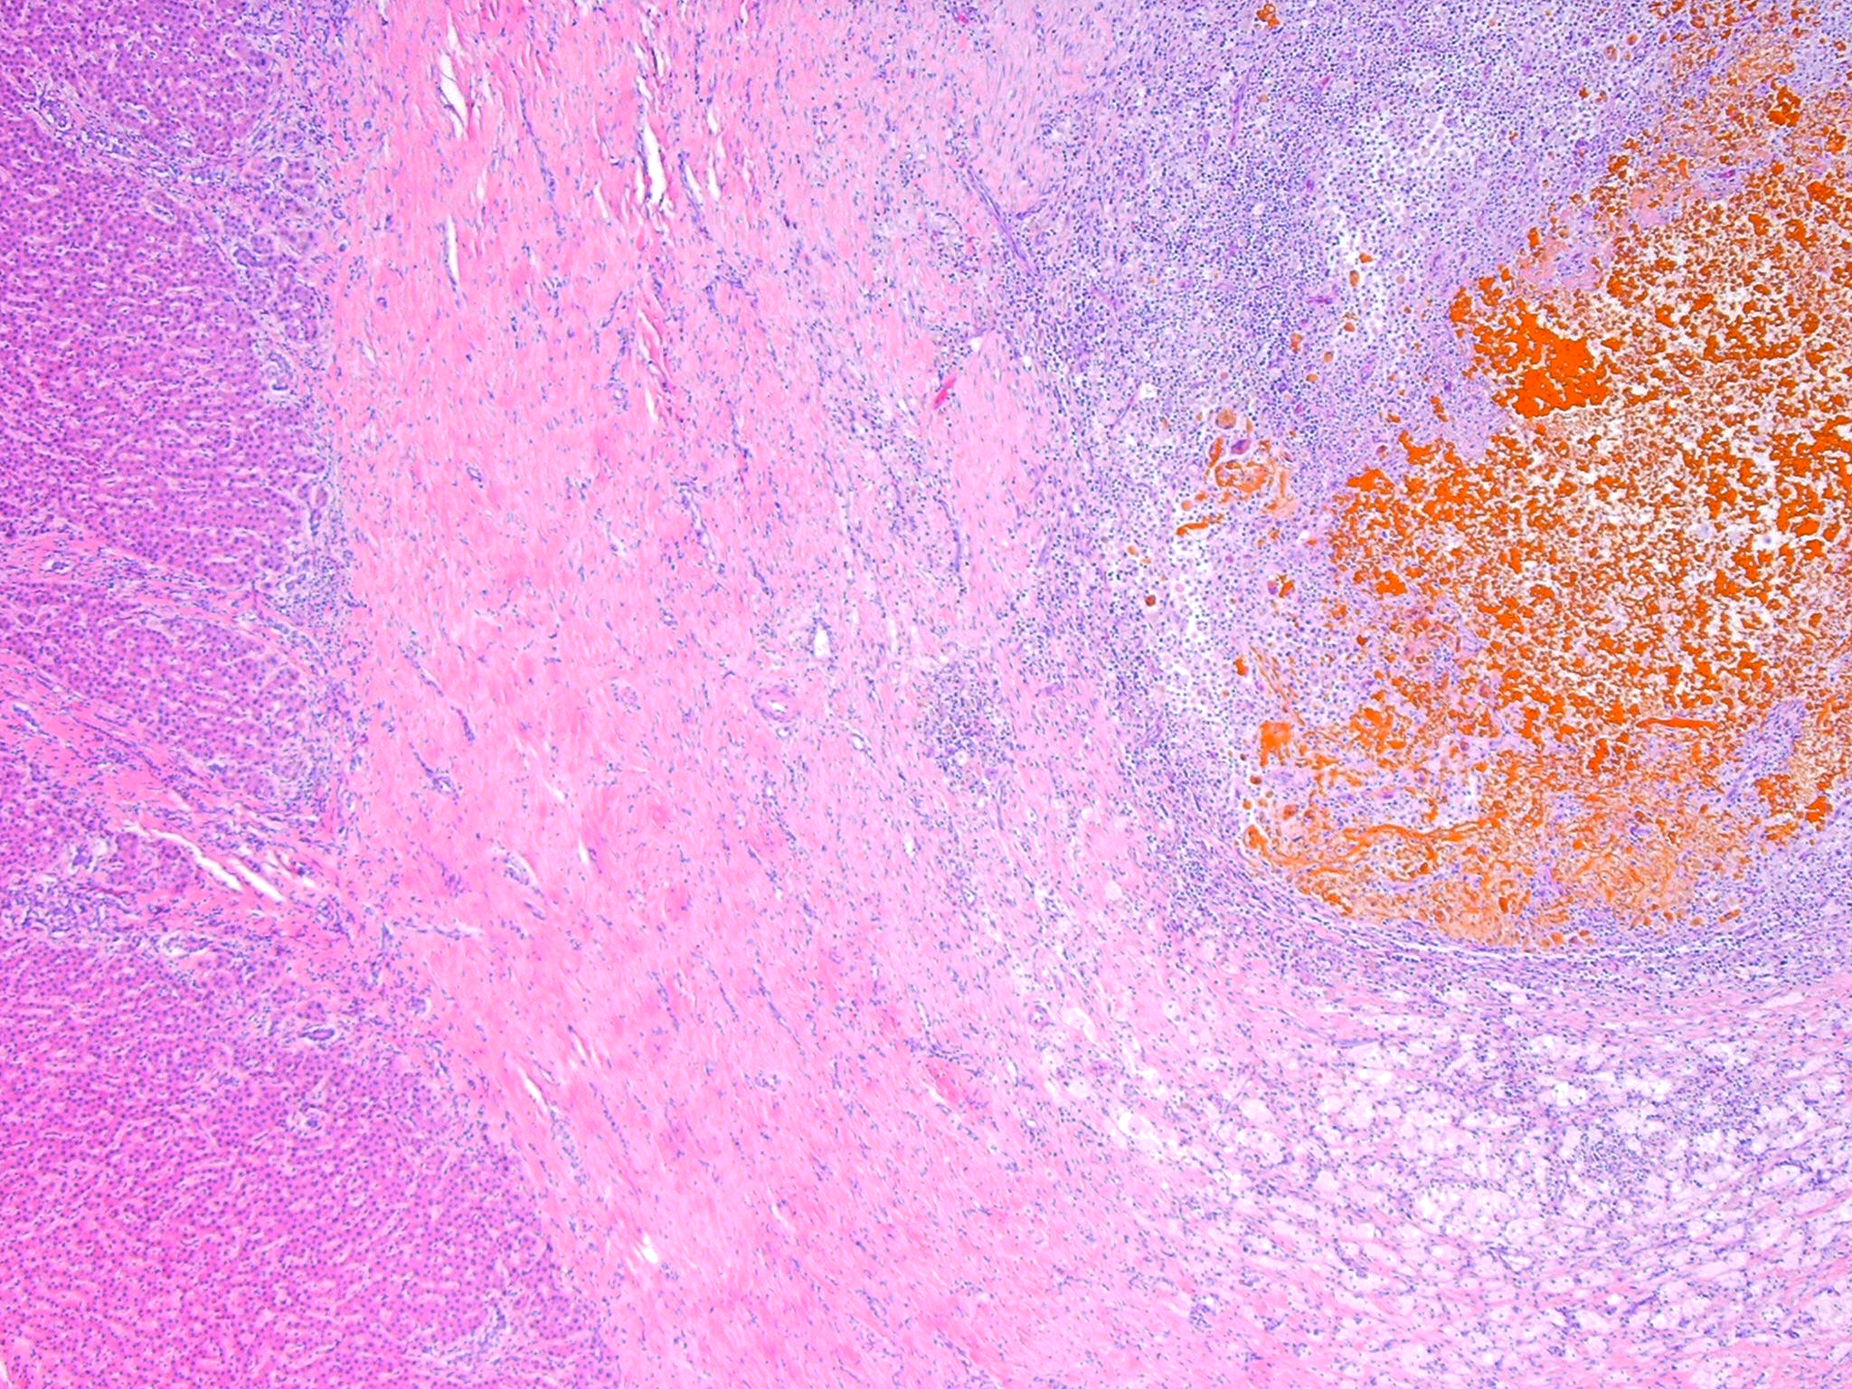
Bile duct strictures in long term survivors

Slide 8
Local Graft Infusion

Slide 9
Notes:
Infections is now the issue

Slide 15
Título

Slide 16
Slide Title

Slide 17
Clinical History
20-30002
74 y.o. F s/p OLT in 1997 for fulminant hepatic necrosis due to nitrofurantoin associated hepatotoxicity
An allograft biopsy 6 weeks post-OLT revealed CMV hepatitis
Mild persistent elevation of serum AST and ALT
An allograft biopsy revealed periportal hepatocyte dropout of unknown etiology
Continued mild elevation of AST/ALT, then a spike to AST of 281
MRCP reveals no biliary dilation
TB = 0.3, AST = 112, ALT = 110, alk phos = 184

Slide 18
DSA testing:
  HLA class II PRA = 94%
  anti-HLA DR53 and DQ7 are donor specific antibodies antigens
  Predicted to yield a positive flow cytometric crossmatch
Request c4d immunostain on prior biopsy

Slide 19
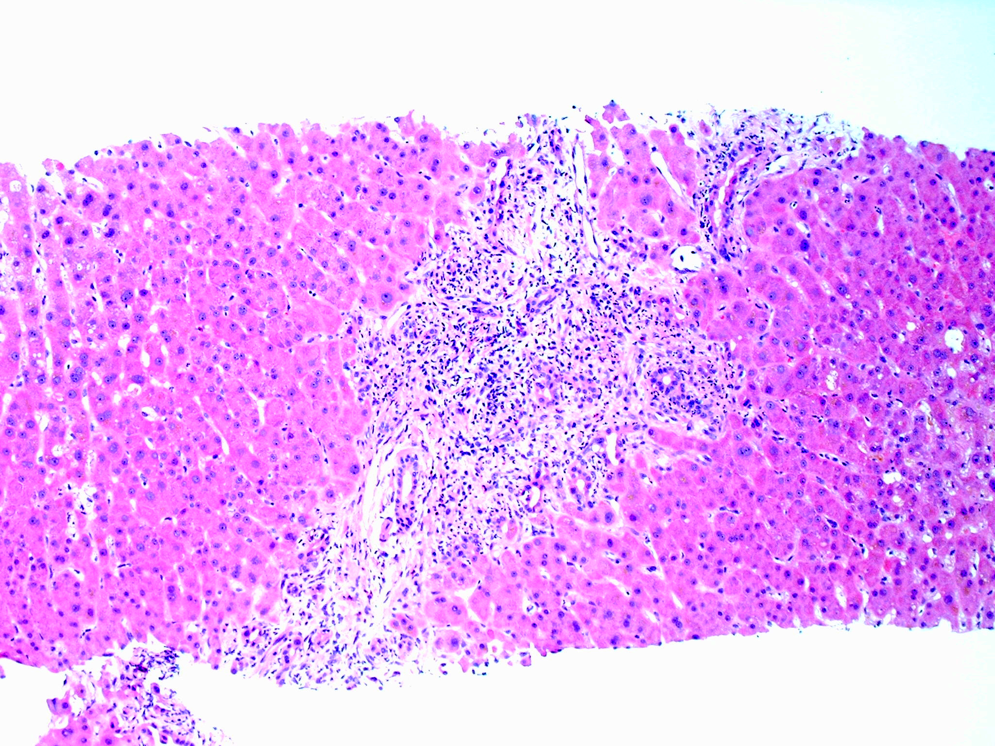

Slide 20
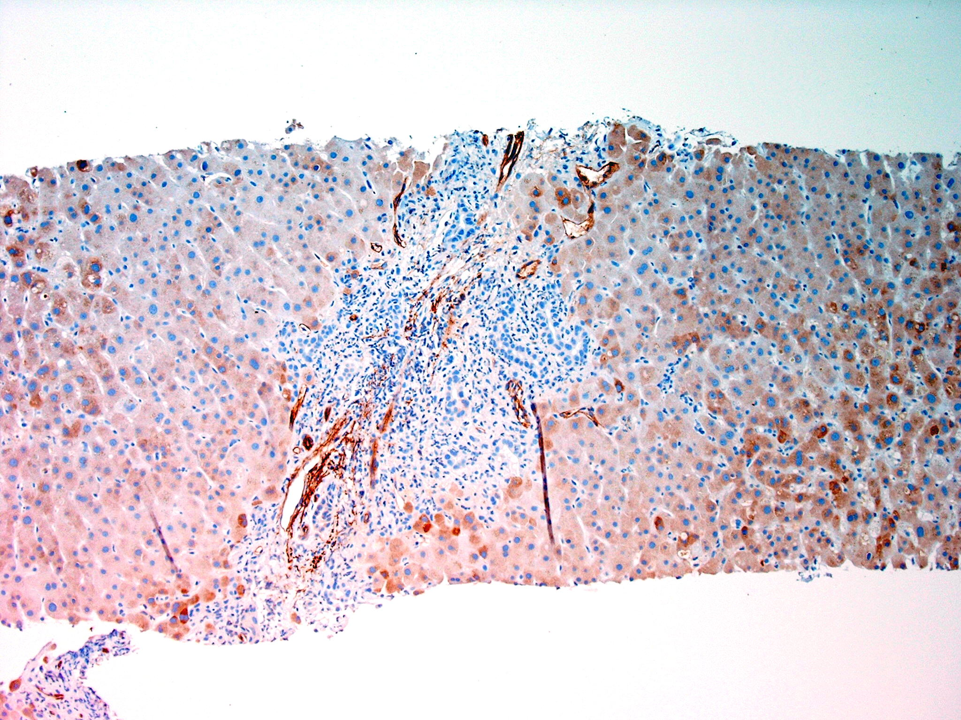
C4d

Slide 21
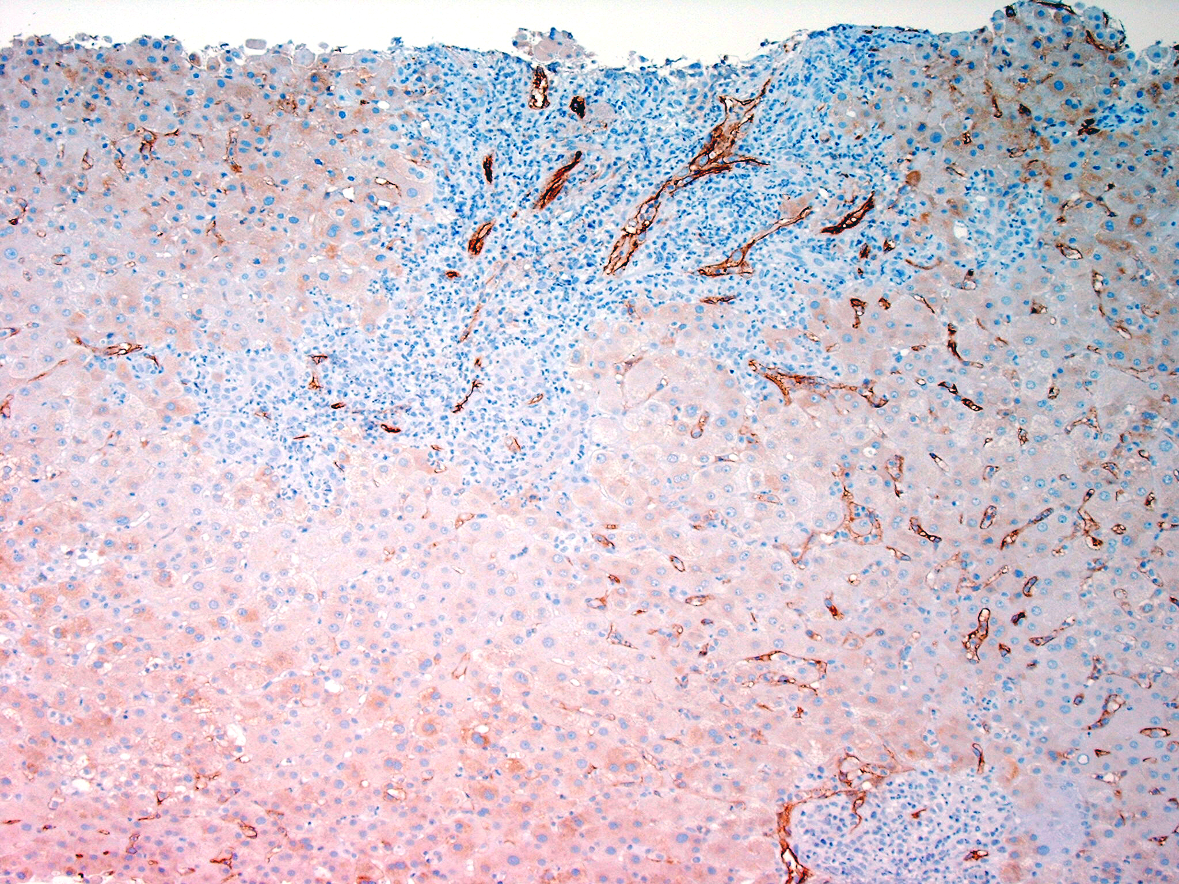
C4d

Slide 22
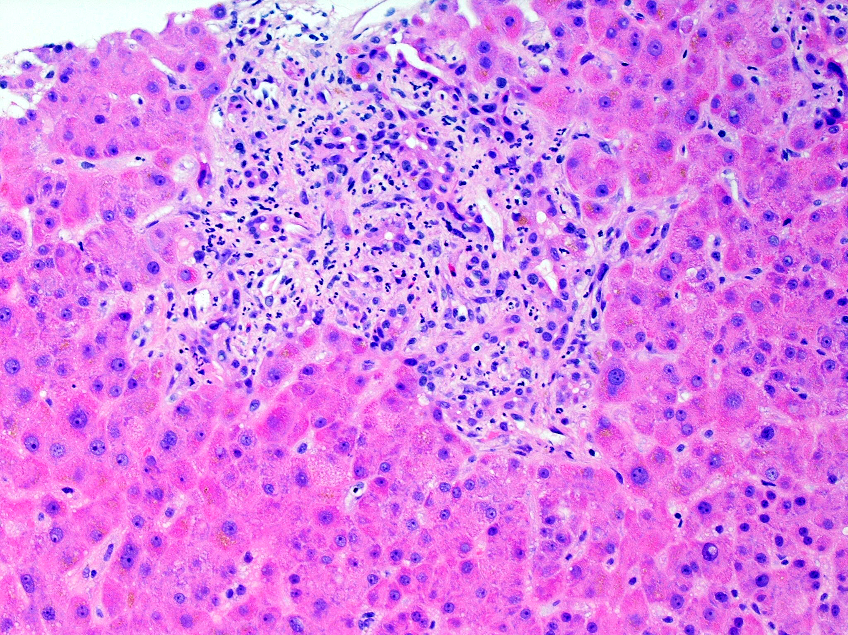

Slide 23
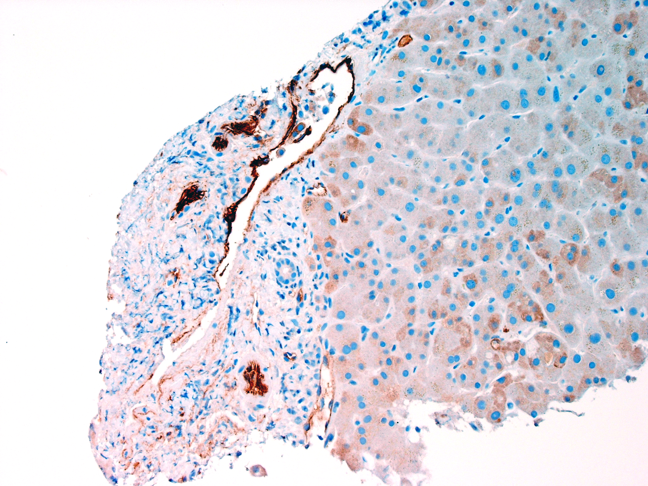
C4d

Slide 24
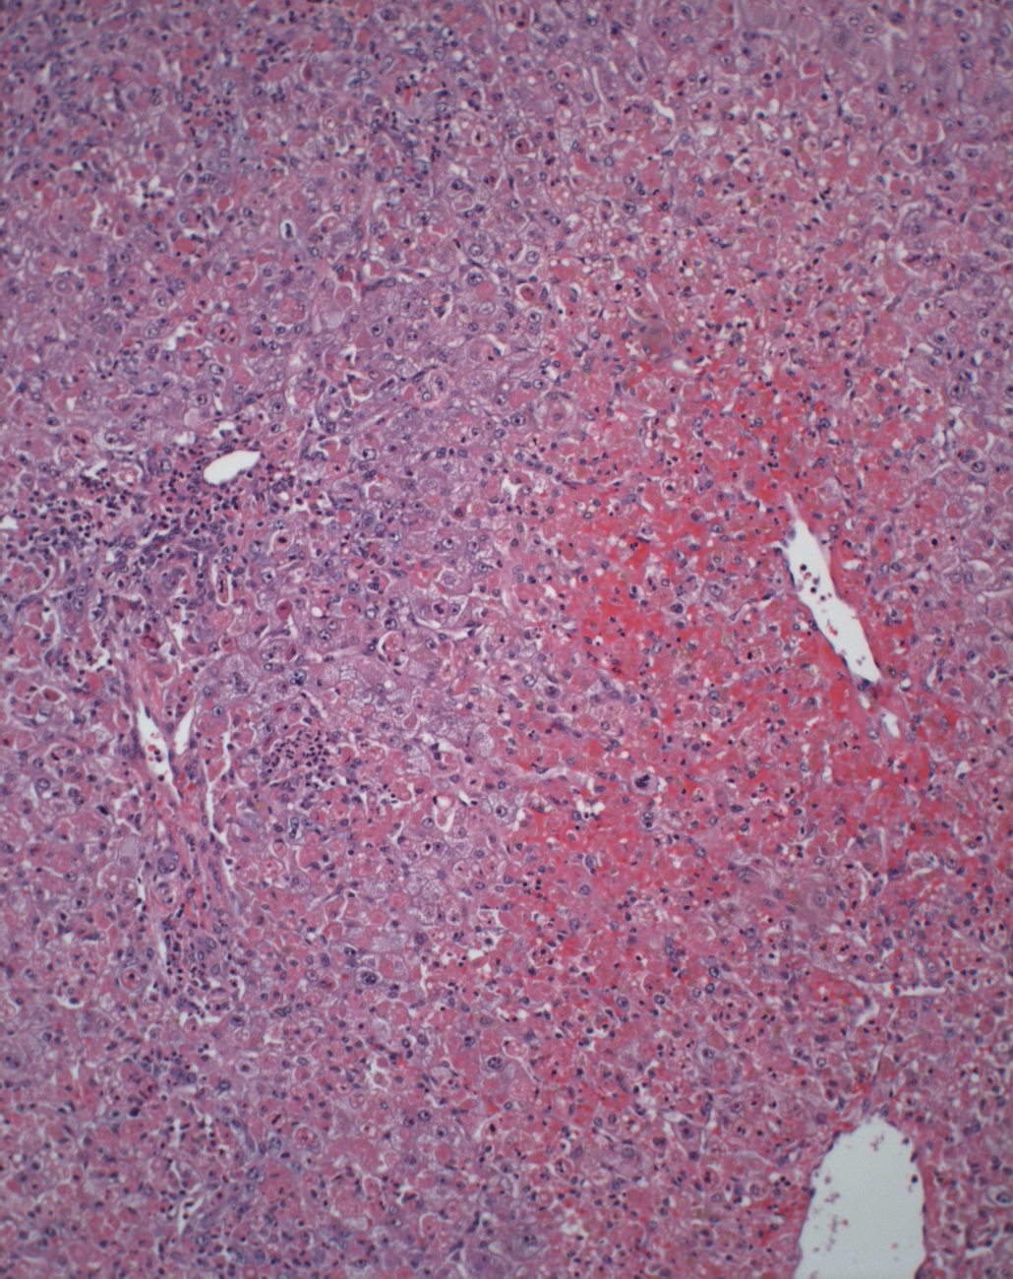
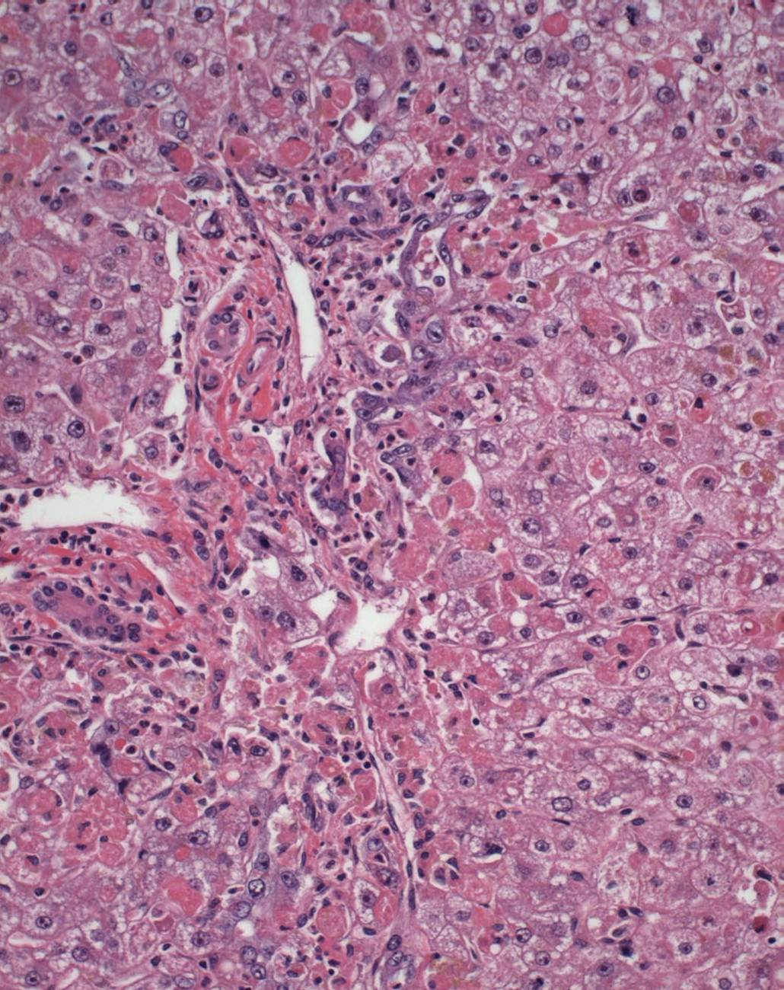
Antibody Mediated Rejection

Slide 25
Antibody Mediated Rejection

Slide 26
C4d Immunostains in Antibody Mediated Rejection

Slide 27
C4d Immunostains in Antibody Mediated Rejection

Slide 28
C4d Immunostains in Antibody Mediated Rejection

Slide 33
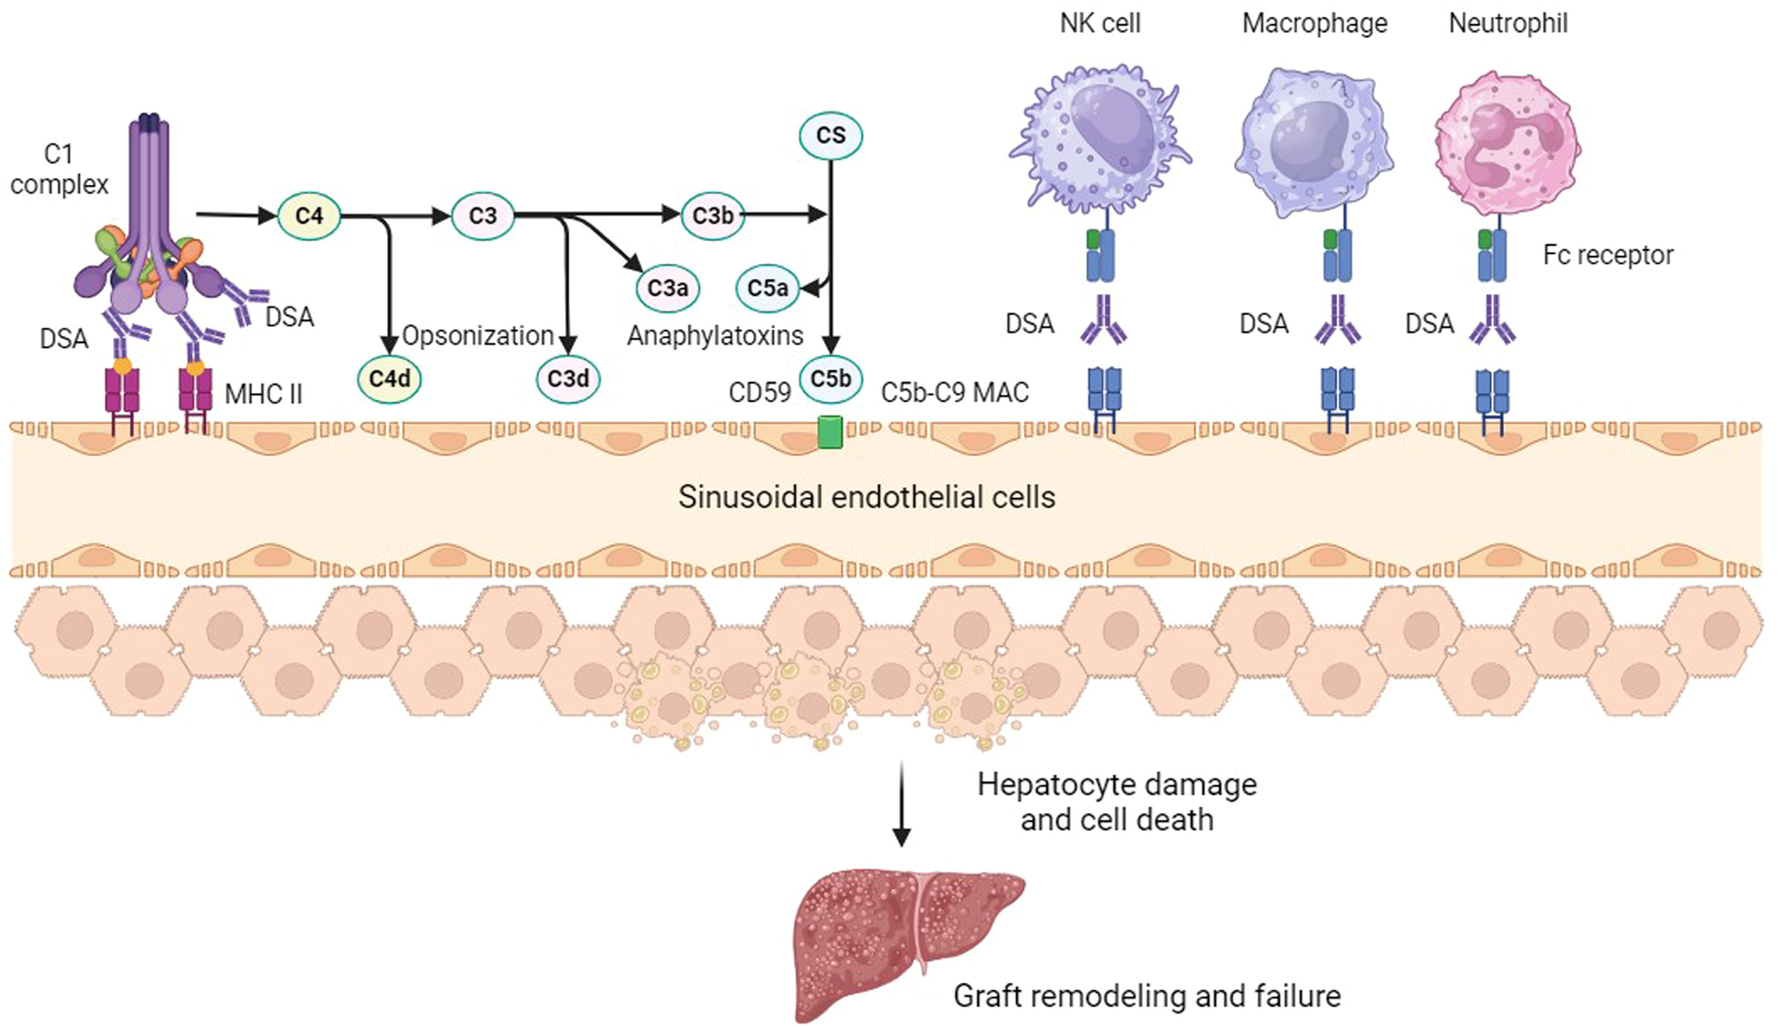

Slide 38
Notes:
Only 5 cases!!! Co-existent AMR and ACR

Slide 42
Combined AMR and ACR

Slide 43
Plasma Cell Rich Rejection formerly De novo Autoimmune Hepatitis
Cause of late allograft dysfunction (after 6 months post-OLT
More common in patients transplanted for chronic HCV hepatitis
Donor-specific antibodies against glutathione S-transferase T1 (GSTT1) enzyme
C4d deposition in portal tract structures

Slide 45
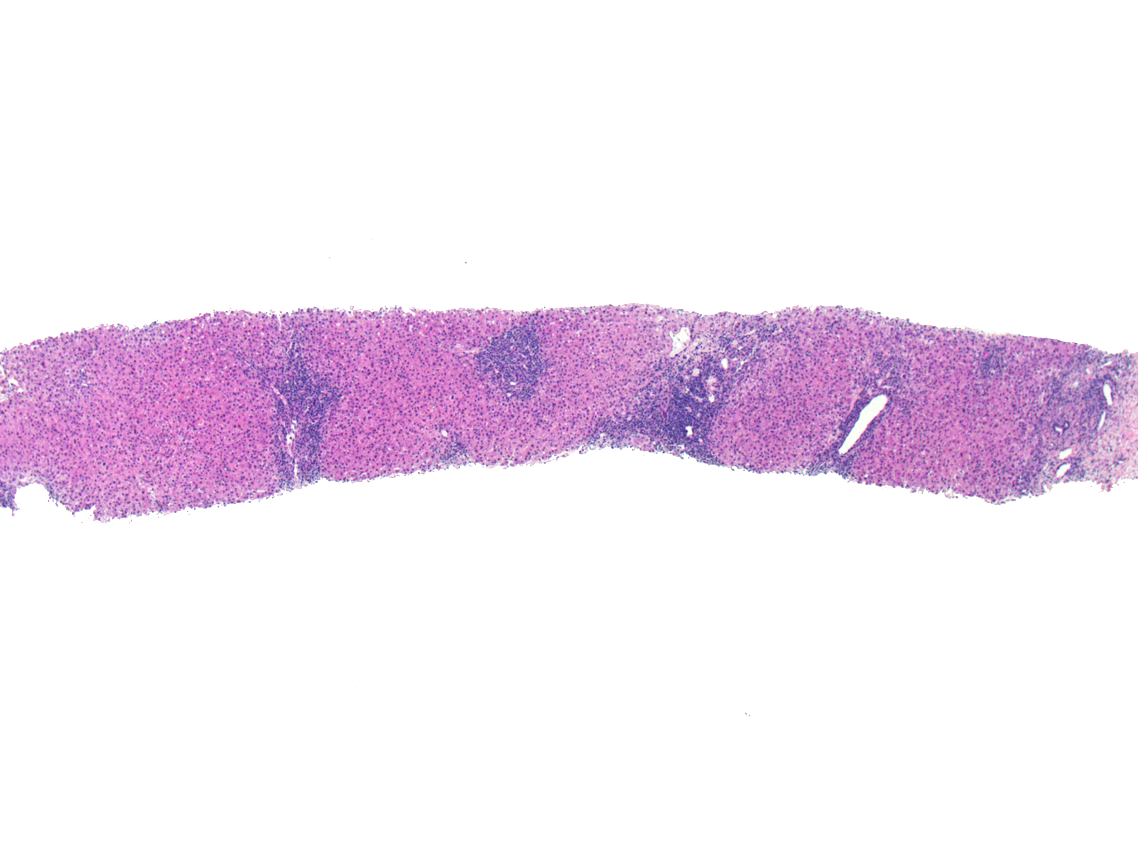

Slide 46
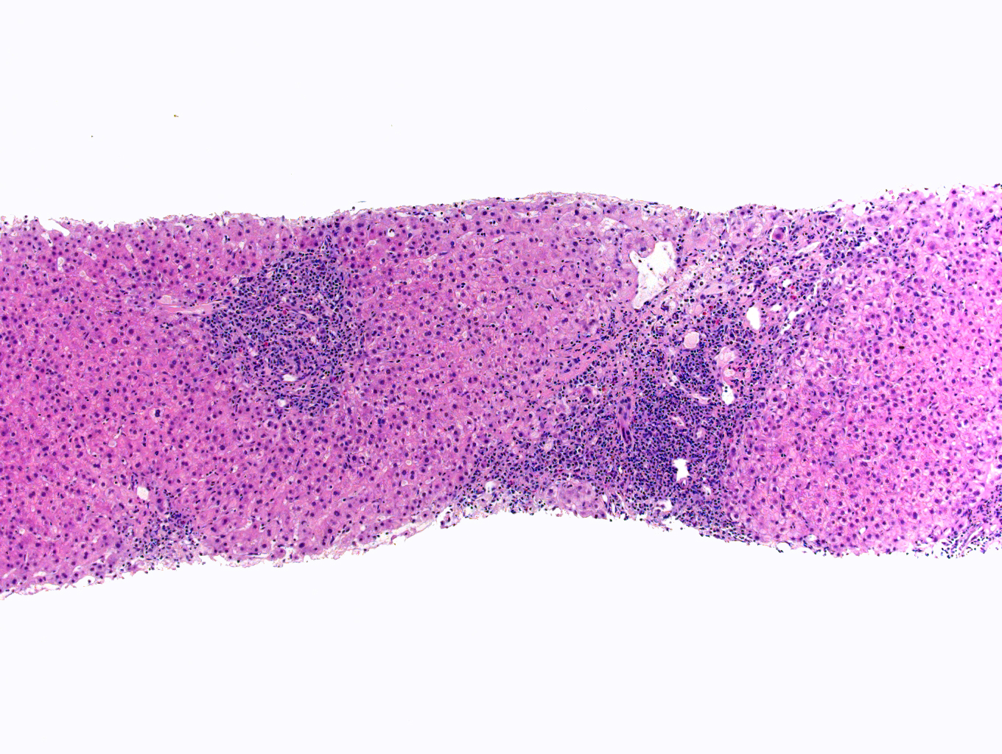

Slide 47
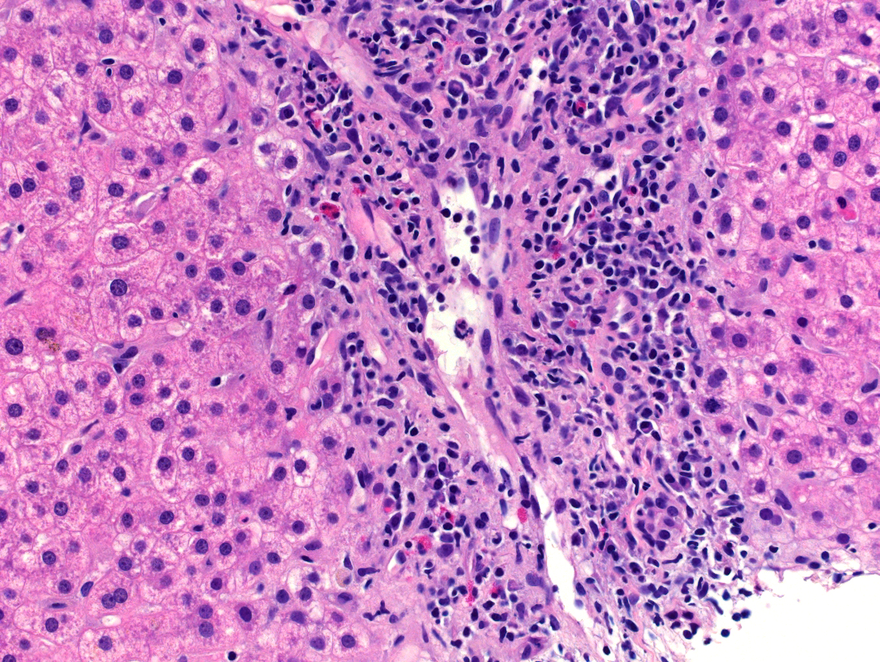

Slide 48
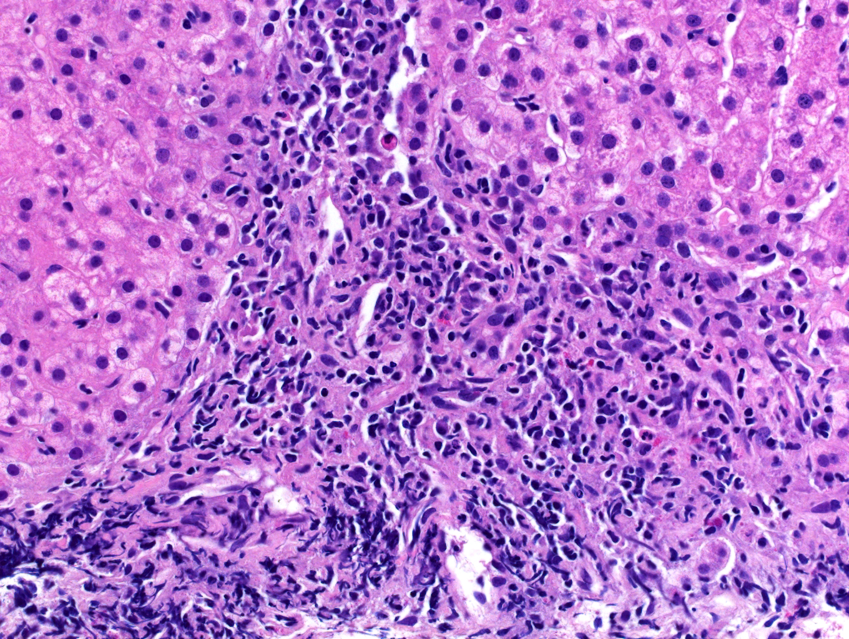

Slide 49
Summary
Antibody Mediated Rejection is rare
Diagnosis of Antibody Mediated Rejection is difficult:
Non-specific H&E histologic features
C4d immunostain difficult to interpret (low sensitivity and specificity)
Co-existent pathology
DSA titers must be considered
Exclusion of other causes of graft dysfunction is important
Treatment of Antibody Mediated Rejection is difficult

Slide 50
obrigado(A)!

